Slide 1
GOM Wells Data Analysis
Progress
29 March 2018

Slide 2
Agenda
Introduction
Summary
Data gathering
Data Analysing
Finding plays
Finding Play type
Finding Well API and Operator
Software

Slide 3
Introduction
Objective is to identify and develop Oil and Gas wells of Lower Tertiary Era in Gulf of Mexico Region.
Major tasks to accomplish are:
Gathering data from the website.
Develops program and performing graphical analysis.
Present result to be available to public in the form of website?

Slide 4
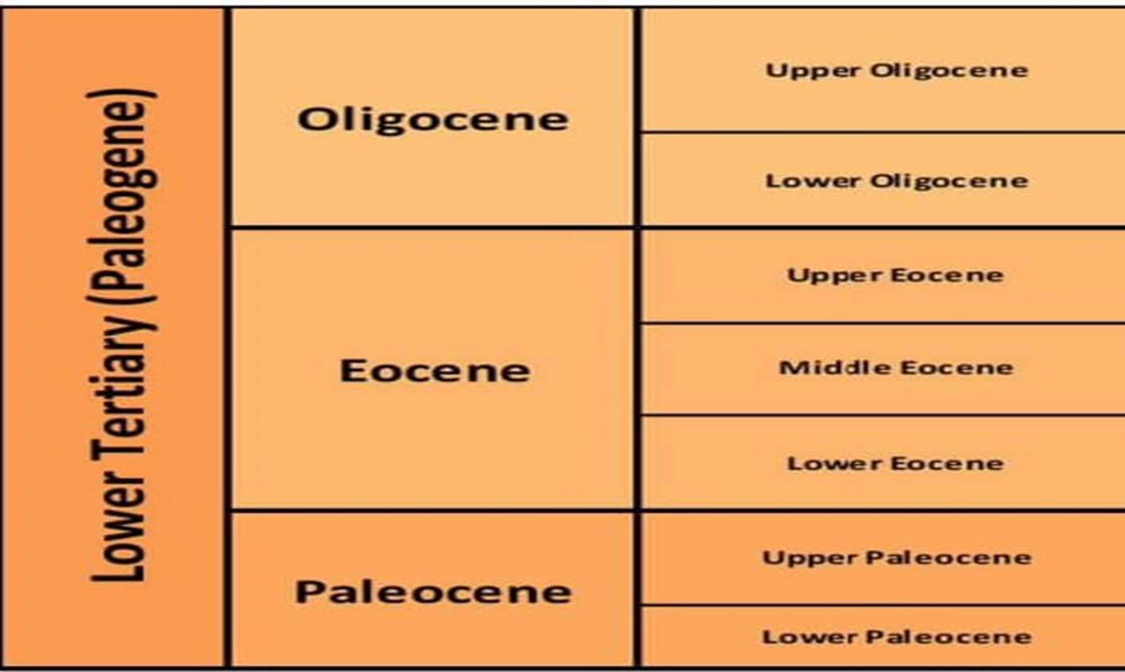
Summary
The Lower Tertiary is Palaeocene in age and known to be the most active age for sand deposition within the Deepwater Gulf of Mexico.
Showing different epochs in Lower tertiary period of Cenozoic era

Slide 5
Data Gathering
Gathering of wells data from the Database that officially placed publicly.
https://www.data.boem.gov/
Search for Gulf of Mexico resource Evaluation.
https://www.boem.gov/Oil-and-Gas-Energy-Program/Resource-Evaluation/Geological-and-Geophysical-Data-Acquisition/GGData-Gulf-of-Mexico.aspx/
Identify geological and geophysical aspects and Chrono zonal data from Sands of Gulf of Mexico
https://www.data.boem.gov/Main/GandG.aspx/

Slide 6
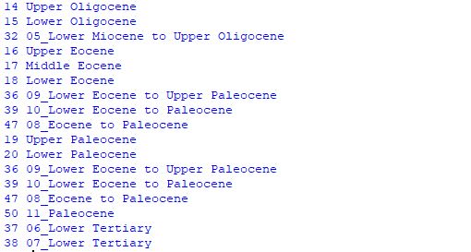
Data Analysing
Automating the Data and analysis on basis of Epoch and Chrono zone
Creating array using different Epochs.
Process of Getting Wells data
Finding of epochs from the sands.
Chrono Zone/Epoch data

Slide 7
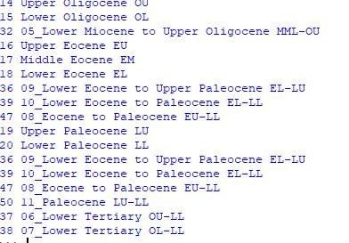
Finding plays
By using Epoch data finding plays of the well.

Slide 8
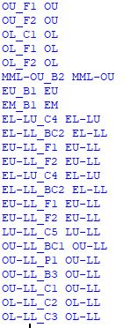
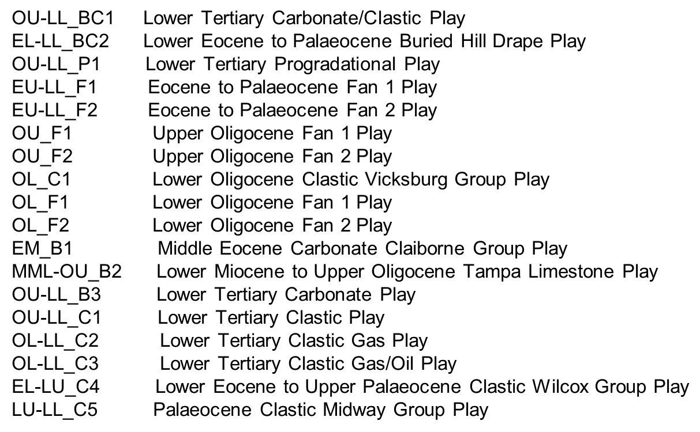
Finding Play type
By using plays data finding Play type.
Play type | Play description

Slide 9
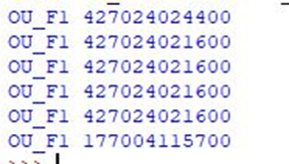
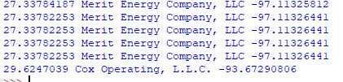
Finding Well API and Operator
By using Play type finding Well API number(unique feature)
By the use of Wells API number finding the surface latitude and surface longitudinal data and company name and respective block data

Slide 10
Software
Module | software | Description | Comments
Xlrd | Python | Reading the data using excel file

Slide 11
THANK YOU
For the opportunity to serve

